Slide 1


Slide 2

What should we do to save our planet?
We should recycle.
to recycle

Slide 3
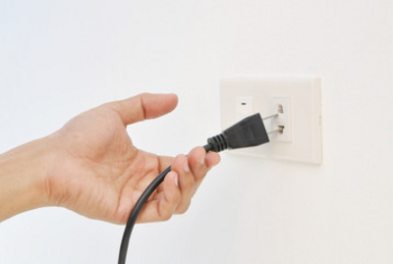
What should we do to save our planet?
We should unplug.
to unplug

Slide 4

What should we do to save our planet?
We should turn off the lights.
to turn off the lights

Slide 5
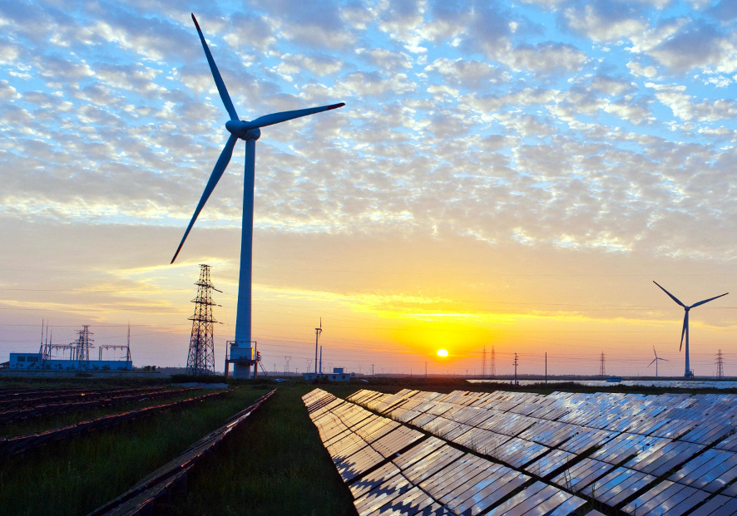
What should we do to save our planet?
We should save energy.
to save energy

Slide 6
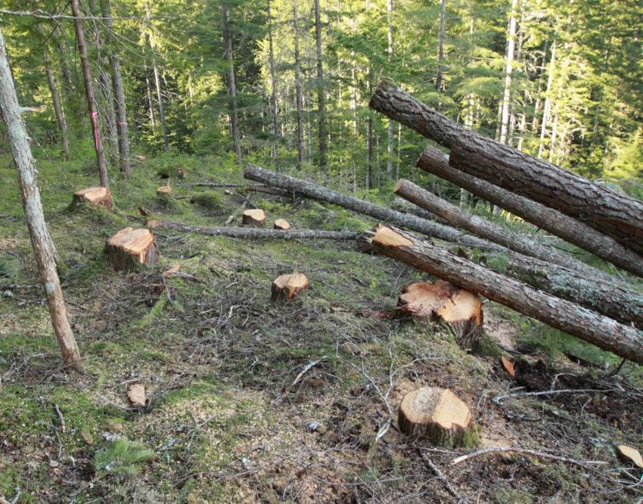
We shouldn’t cut down trees.
to cut down trees

Slide 7
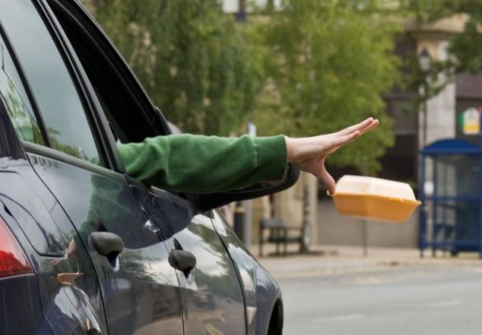
We shouldn’t drop litter.
to drop litter

Slide 8
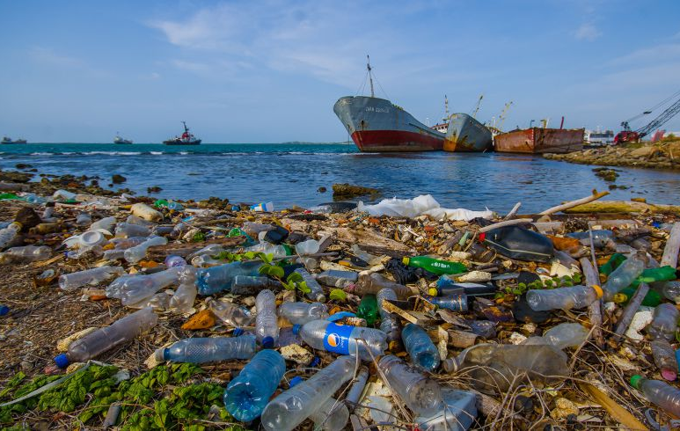
We shouldn’t pollute the seas.
to pollute the seas

Slide 9
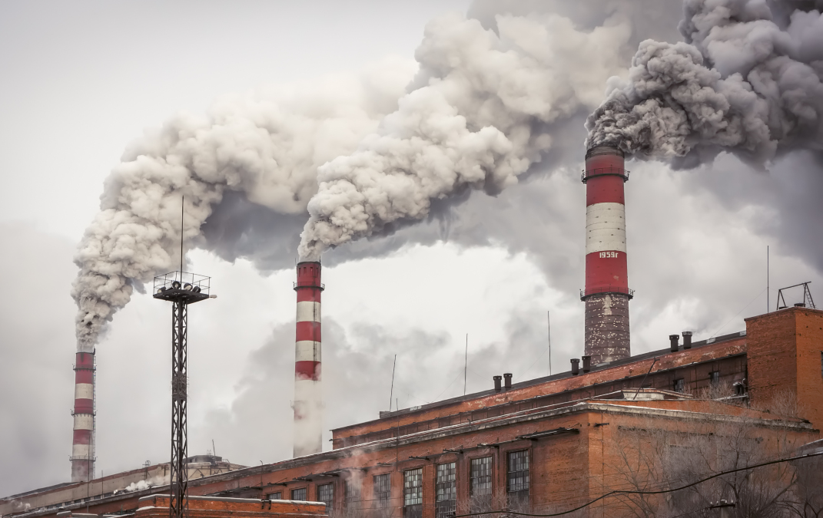
We shouldn't pollute the air.
to pollute the air

Slide 10
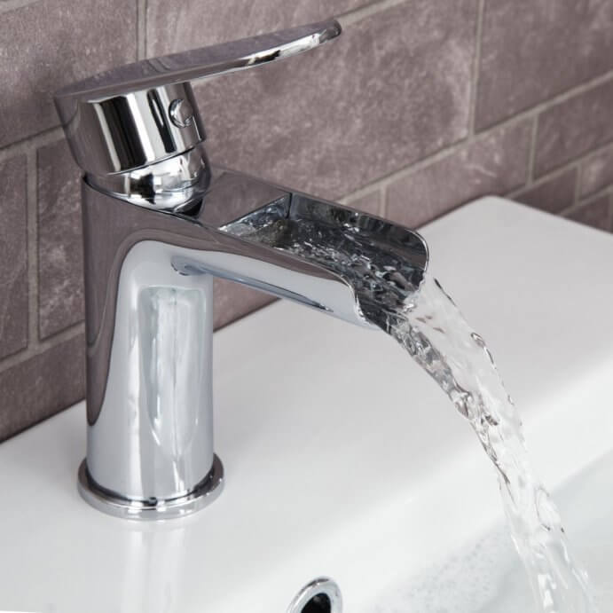
We shouldn’t waste water.
to waste water

Slide 11
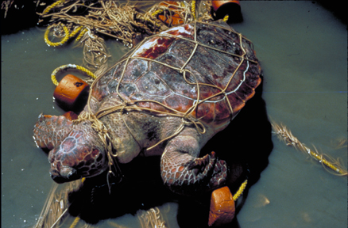
We shouldn’t harm animals.
to harm animals

